Slide 1



PYTHON VARIABLES

Slide 2

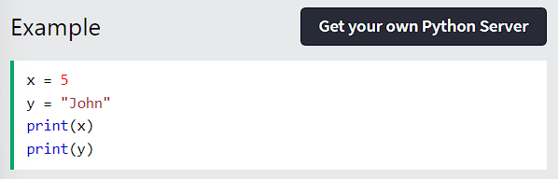
PYTHON VARIABLES
VARIABLES
Variables are containers for storing data values.
CREATING VARIABLES
Python has no command for declaring a variable.
A variable is created the moment you first assign a value to it.
Python - Variables

Slide 3
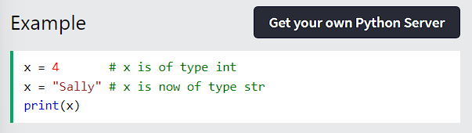
PYTHON VARIABLES
Variables do not need to be declared with any particular type, and can even change type after they have been set.
Python - Variables

Slide 4
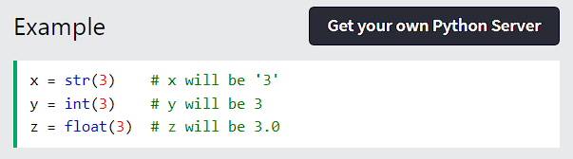

PYTHON VARIABLES
CASTING
If you want to specify the data type of a variable, this can be done with casting.
Python - Variables

Slide 5
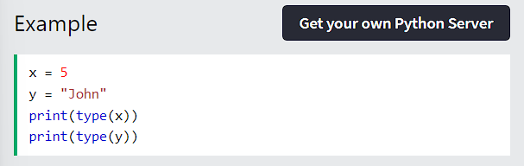
PYTHON VARIABLES
GET THE TYPE
You can get the data type of a variable with the type() function.
Python - Variables

Slide 6
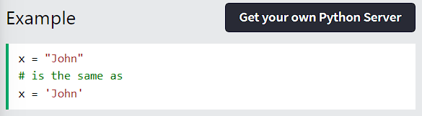
PYTHON VARIABLES
SINGLE OR DOUBLE QUOTES ?
String variables can be declared either by using single or double quotes:
Python - Variables

Slide 7
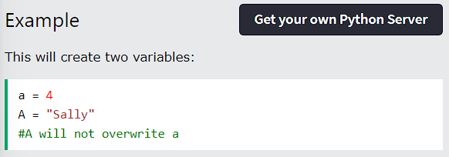
PYTHON VARIABLES
CASE-SENSITIVE
Variable names are case-sensitive.
Python - Variables

Slide 8



THANK YOU

Slide 9

PYTHON
VARIABLE NAMES

Slide 10
PYTHON - VARIABLE NAMES
Variable Names
A variable can have a short name (like x and y) or a more descriptive name (age, carname, total_volume). Rules for Python variables:
A variable name must start with a letter or the underscore character A variable name cannot start with a number
A variable name can only contain alpha-numeric characters and underscores (A-z, 0-9, and _ )
Variable names are case-sensitive (age, Age and AGE are three different variables)
Python - Variables - Variable Names

Slide 11
Remember that variable names are case-sensitive
Python - Variables - Variable Names

Slide 12

PYTHON - VARIABLE NAMES
Multi Words Variable Names
Variable names with more than one word can be difficult to read.
There are several techniques you can use to make them more readable:
Camel Case
Each word, except the first, starts with a capital letter:
Python - Variables - Variable Names

Slide 13

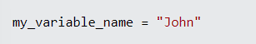
PYTHON - VARIABLE NAMES
Pascal Case
Each word starts with a capital letter:
Snake Case
Each word is separated by an underscore character:
Python - Variables - Variable Names

Slide 14
THANK YOU

Slide 15

PYTHON VARIABLES ASSIGN MULTIPLE VALUES

Slide 16
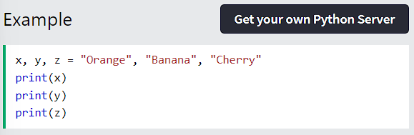
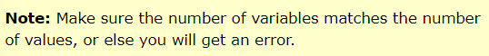
ASSIGN MULTIPLE VALUES
MANY VALUES TO MULTIPLE VARIABLES
Python allows you to assign values to multiple variables in one line:
Python - Variables -
Assign Multiple Values

Slide 17
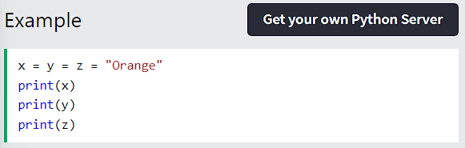
ASSIGN MULTIPLE VALUES
ONE VALUE TO MULTIPLE VARIABLES
And you can assign the same value to multiple variables in one line:
Python - Variables -
Assign Multiple Values

Slide 18
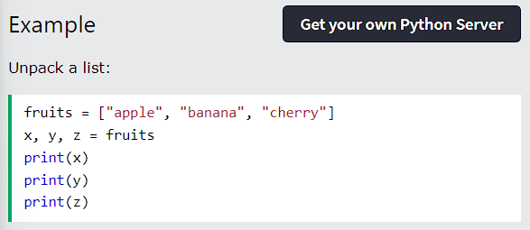
ASSIGN MULTIPLE VALUES
UNPACK A COLLECTION
If you have a collection of values in a list, tuple etc. Python allows you to extract the values into variables. This is called unpacking.
Python - Variables -
Assign Multiple Values

Slide 19

THANK YOU

Slide 20
PYTHON
OUTPUT VARIABLES

Slide 21
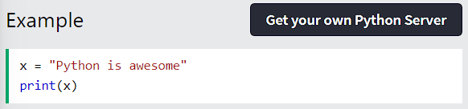
PYTHON - OUTPUT VARIABLES
Output Variables
The Python print() function is often used to output variables.
In the print() function, you output multiple variables, separated by a comma:
Python - Variables - Output Variables

Slide 22
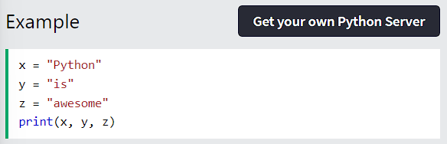
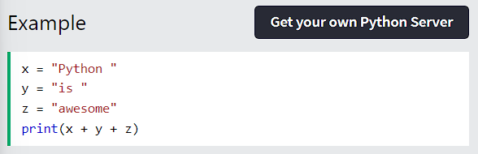
PYTHON - OUTPUT VARIABLES
You can also use the + operator to output multiple variables:
Python - Variables - Output Variables

Slide 23
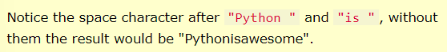
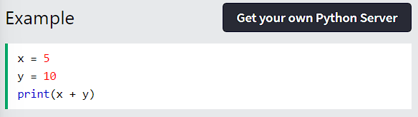
PYTHON - OUTPUT VARIABLES
For numbers, the + character works as a mathematical operator:
Python - Variables - Output Variables

Slide 24
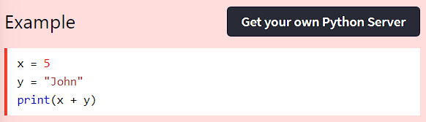
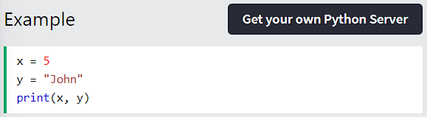
PYTHON - OUTPUT VARIABLES
In the print() function, when you try to combine a string and a number with the + operator, Python will give you an error:
The best way to output multiple variables in the print() function is to separate them with commas, which even support different data types:
Python - Variables - Output Variables

Slide 25
THANK YOU

Slide 26

PYTHON GLOBAL VARIABLES

Slide 27
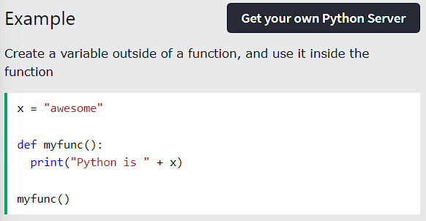
PYTHON GLOBAL VARIABLES
GLOBAL VARIABLES
Variables that are created outside of a function (as in all of the examples above) are known as global variables.
Global variables can be used by everyone, both inside of functions and outside.
Python - Variables -
Global Variables

Slide 28
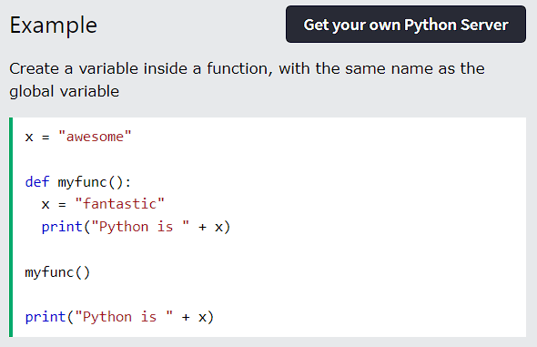
PYTHON GLOBAL VARIABLES
If you create a variable with the same name inside a function, this variable will be local, and can only be used inside the function. The global variable with the same name will remain as it was, global and with the original value.
Python - Variables -
Global Variables

Slide 29
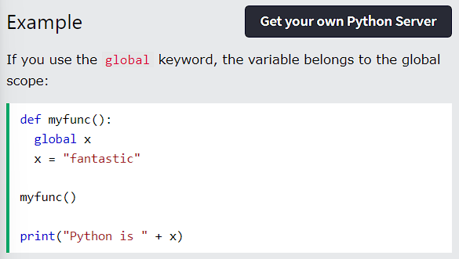
PYTHON GLOBAL VARIABLES
THE GLOBAL KEYWORD
Normally, when you create a variable inside a function, that variable is local, and can only be used inside that function.
To create a global variable inside a function, you can use the global keyword.
Python - Variables -
Global Variables

Slide 30
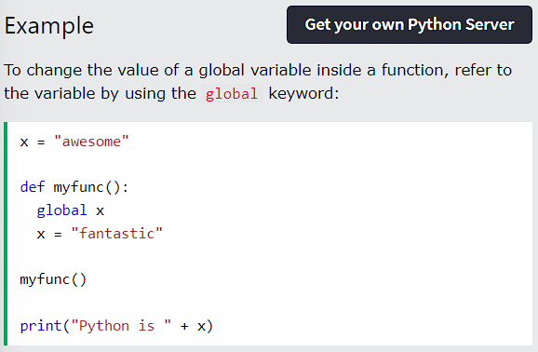
PYTHON GLOBAL VARIABLES
Also, use the global keyword if you want to change a global variable inside a function.
Python - Variables -
Global Variables

Slide 31
THANK YOU

Slide 32
PYTHON
VARIABLE EXERCISES

Slide 33
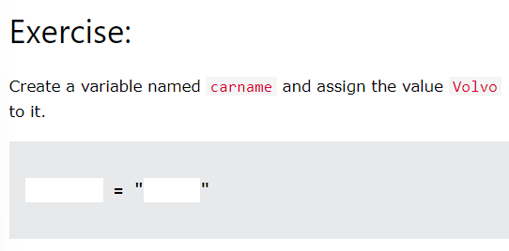
PYTHON - VARIABLE EXERCISES
Test Yourself With Exercises
Now you have learned a lot about variables, and how to use them in Python. Are you ready for a test?
Try to insert the missing part to make the code work as expected:
Python - Variables - Variable Exercises

Slide 34
THANK YOU

